Slide 1
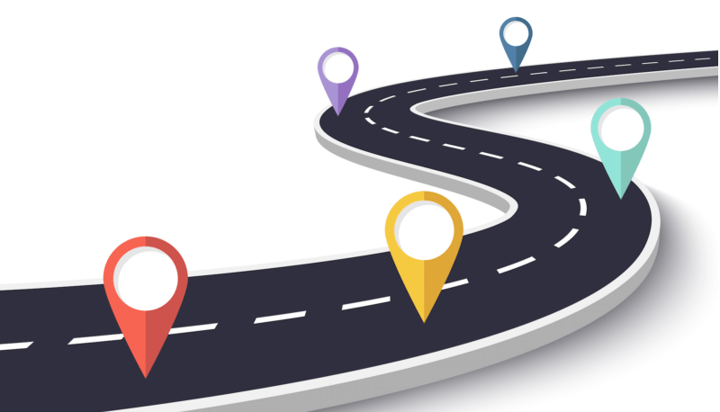

Customer Journey

Slide 2



Customer Journey
Channel | Aware | Interest | Purchase | Re-purchase
Google
Youtube
Facebook
Website
E-mail
Store
On-line Store
Call center
Googled to find information. Found several reviews on the internet.
Watch several clip reviews and became interested to buy.
Saw a friend use tablet with pencil for on-line learning.
Read several reviews and check product details and price comparison to buy.
Spend way too long to get iPad.
Receive the next purchase coupon.
Visited the store to try out the iPad. Failed to search for target product and discount at the Apple store.
Visited the online store. Find out the target product and get the discount as expected.
Could not find other iPad accessories to buy.
Complaint about the late delivery.

Slide 3
Customer Journey with Data Analytics
Channel | Aware | Interest | Purchase | Re-purchase
Google
Youtube
Facebook
Website
E-mail
Store
On-line Store
Call center
Googled to find information. Found several reviews on the internet.
Watch several clip reviews and became interested to buy.
Customer Segmentation
Saw a friend use tablet with pencil for on-line learning.
Read several reviews and check product details and price comparison to buy.
Conversion Analysis
Spend way too long to get iPad.
Receive the next purchase coupon.
Visited the store to try out the iPad. Failed to search for target product and discount at the Apple store.
Visited the online store. Find out the target product and get the discount as expected.
Could not find other iPad accessories to buy.
Chatbot Call center
Product Recommendation
Complaint about the late delivery.

Slide 4
Customer Journey with Data collection
Channel | Aware | Interest | Purchase | Re-purchase
Google
Youtube
Facebook
Website
E-mail
Store
On-line Store
Call center
Googled to find information. Found several reviews on the internet.
Google Analytics
Watch several clip reviews and became interested to buy.
Java script with Youtube API
Saw a friend use tablet with pencil for on-line learning.
Read several reviews and check product details and price comparison to buy.
Web scrapping
Spend way too long to get iPad.
Receive the next purchase coupon.
Visited the store to try out the iPad. Failed to search for target product and discount at the Apple store.
Visited the online store. Find out the target product and get the discount as expected.
Could not find other iPad accessories to buy.
Firebase
Complaint about the late delivery.
Campaign response model,
Automatic E-mail

